Slide 1
RNA Library Prep for ONT metagenomics
Rapid Response – Revised 01/12/2026

Slide 2
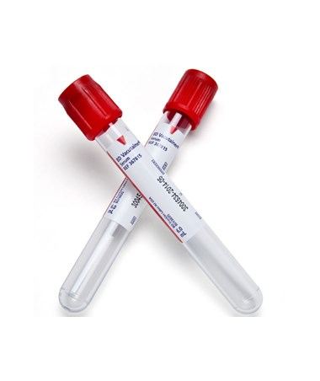
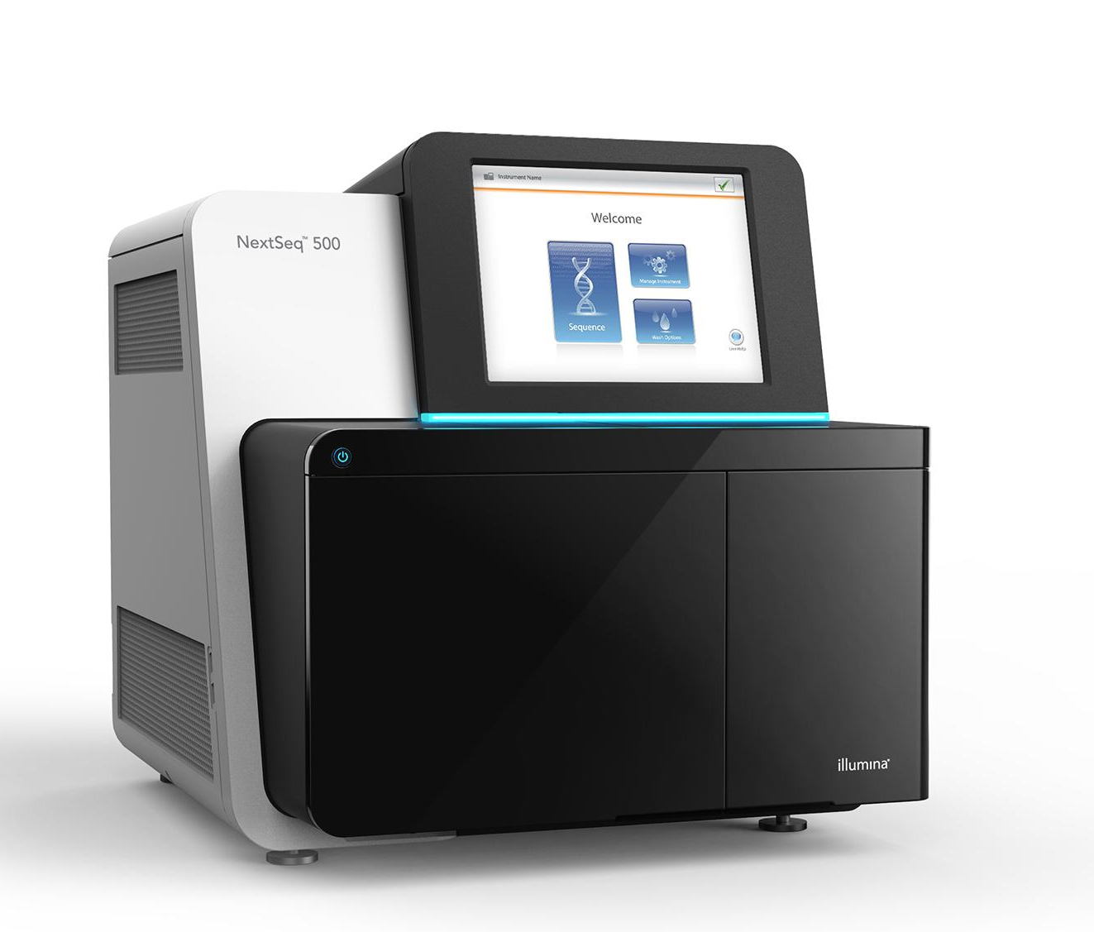
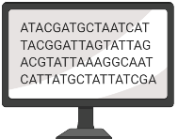
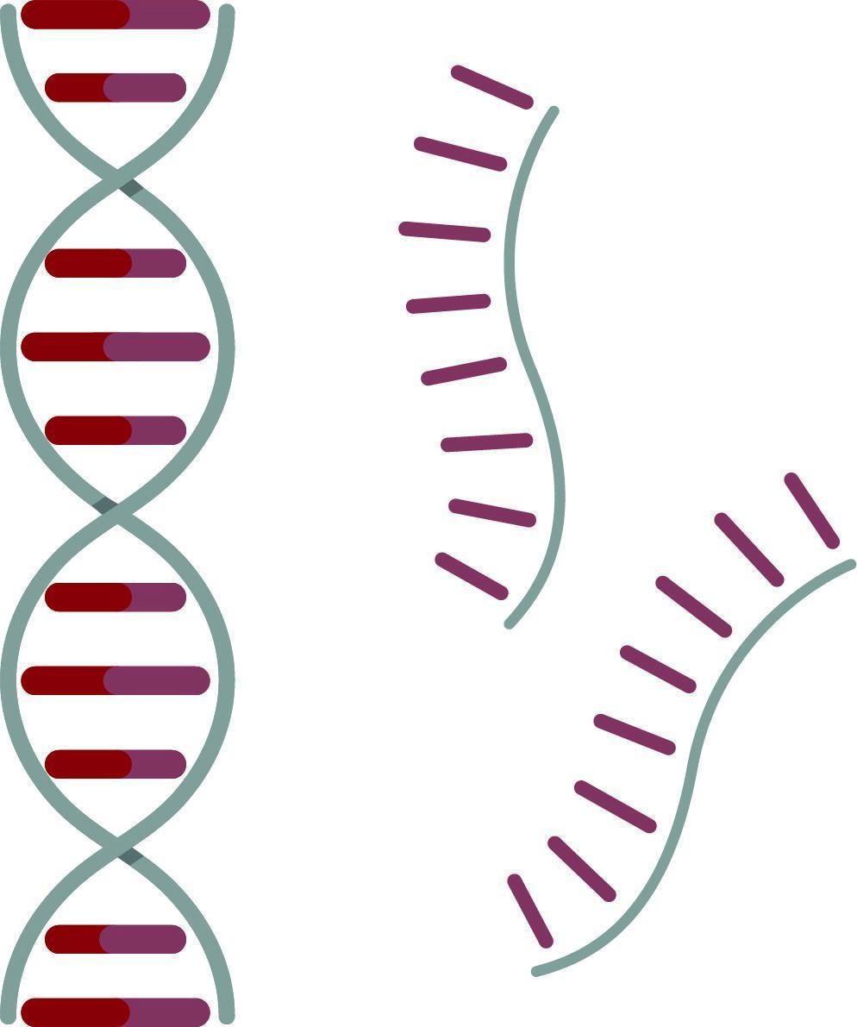
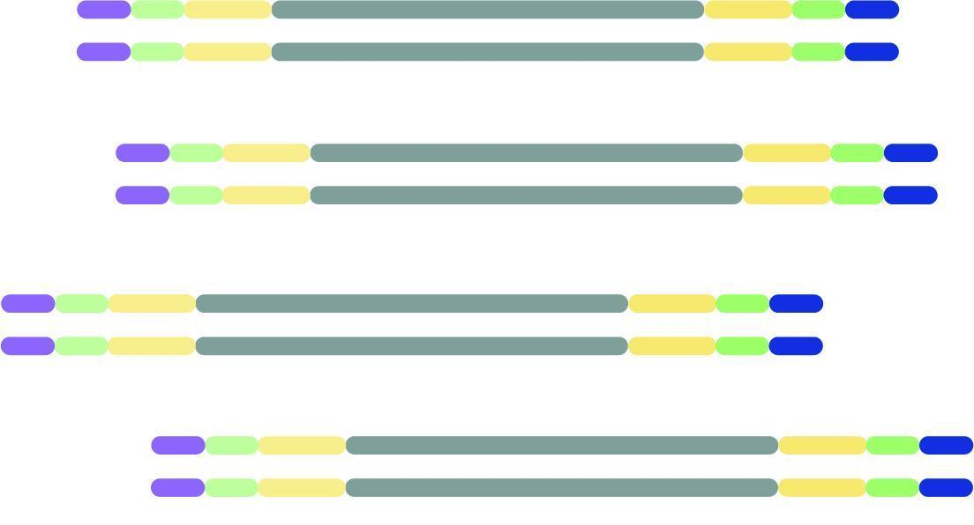

mNGS pipeline
Study design
Nucleic acid extraction
Library prep
Sequencing
Data analysis
Pathogen ID

Slide 3
Nucleic acid extraction

Slide 4
xNA extraction
Key points:
✓ Minimize cross-contamination
✓ Preserve sample quality
Before extraction:
Spin down to remove host cells (extract supernatant)
Choose type:
DNA:
Detect bacteria, parasites, fungi, DNA viruses
RNA:
All the above + RNA viruses (!)
Requires optimal sample quality, degrades very fast
Keep cold at all times!
TNA (total nucleic acid):
DNA + RNA
Requires DNAse I step for RNA-mNGS
Column vs bead-based extraction
Notes:
Before extraction, try to get rid of as much host material as possible, by for example spinning down the material and using the supernatant for extraction.
Nucleic acid type depends on your research question since it will affect what you’ll be able to pick up: go for RNA if you are also interested in viruses, provided you have good sample quality. If just interested in bacteria, you can do DNA.
TNA: extract both DNA and RNA, and decide later what type of library you’ll prepare.
Column vs bead-based extraction: Bead-based extractions are easier to perform, especially when working with larger sample sizes.. You will need magnetic stands though. Whatever type of extraction you do, it will be crucial to avoid cross-contamination as much as possible. You can do this by interspersing samples with water controls during extraction, for example. Also make sure to preserve sample quality, this will be especially important when extracting RNA. Avoid freeze-thaw cycles of RNA and keep it cold at all times.

Slide 5
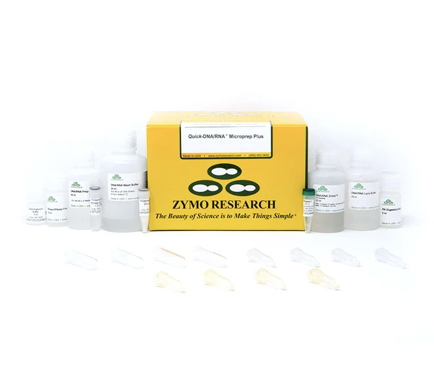
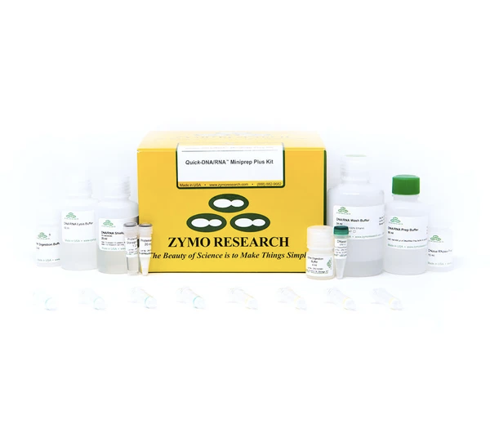
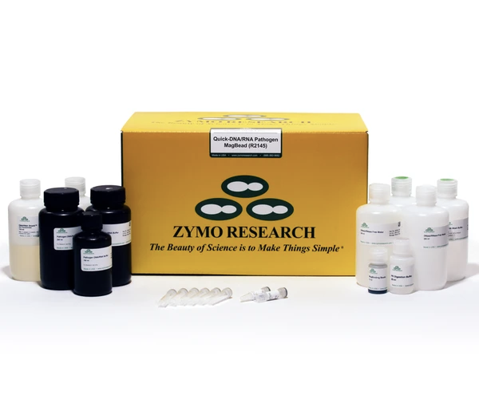
xNA extraction
Zymo DNA+RNA extraction kits
Quick-DNA/RNA Microprep Plus
Quick-DNA/RNA Miniprep Plus
Quick-DNA/RNA Pathogen Magbead
50 preps for $399
50 preps for $399
96 preps for $293
Column-based
Column-based
Bead-based
Requires extra:
Magnet stand (CZB Engineers)
β-mercaptoethanol
Extra reagents to buy:
Molecular grade ethanol (200 proof) for washes
Isopropanol to add to concentrated wash buffers
DNase I included in regular quick-DNA/RNA kits, but not in Pathogen kits
Available separately from Qiagen: RNase-Free DNase Set, $512 for 250 samples
Notes:
Amount of pathogen can be very low (eg CSF) -> microkit or Magbead kit.
Clogging issue for columns (use Proteinase K! see protocol serum/plasma), but not with magbead (also includes Prot K). BME will also help degrade cell walls, …
DNA/RNA kits are more expensive than just the DNA or RNA kit, but worth it coz you’ll have both
Note: Pathogen magbead is about 20% cheaper than the regular magbead kit for 96 samples, mainly because Path kit does not include DNAseI while regular kit does have it.

Slide 6
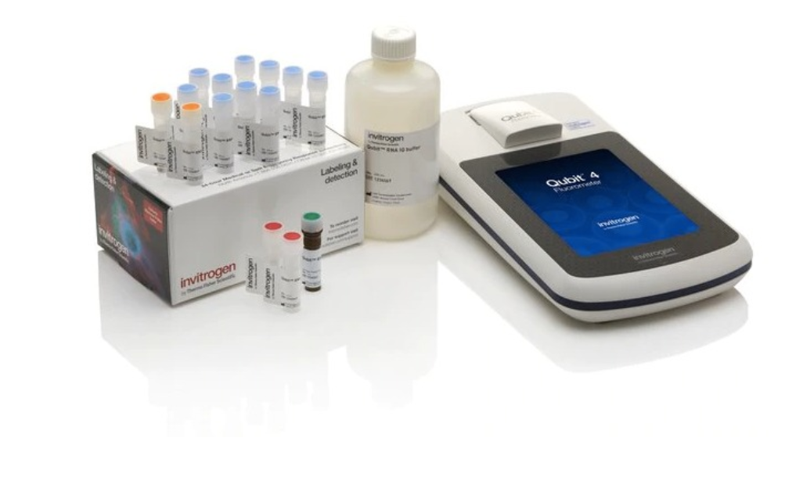
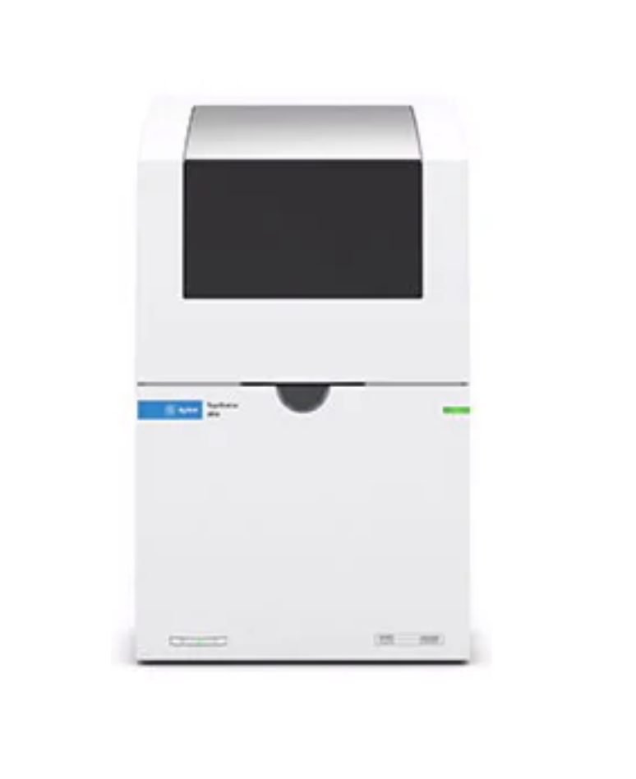
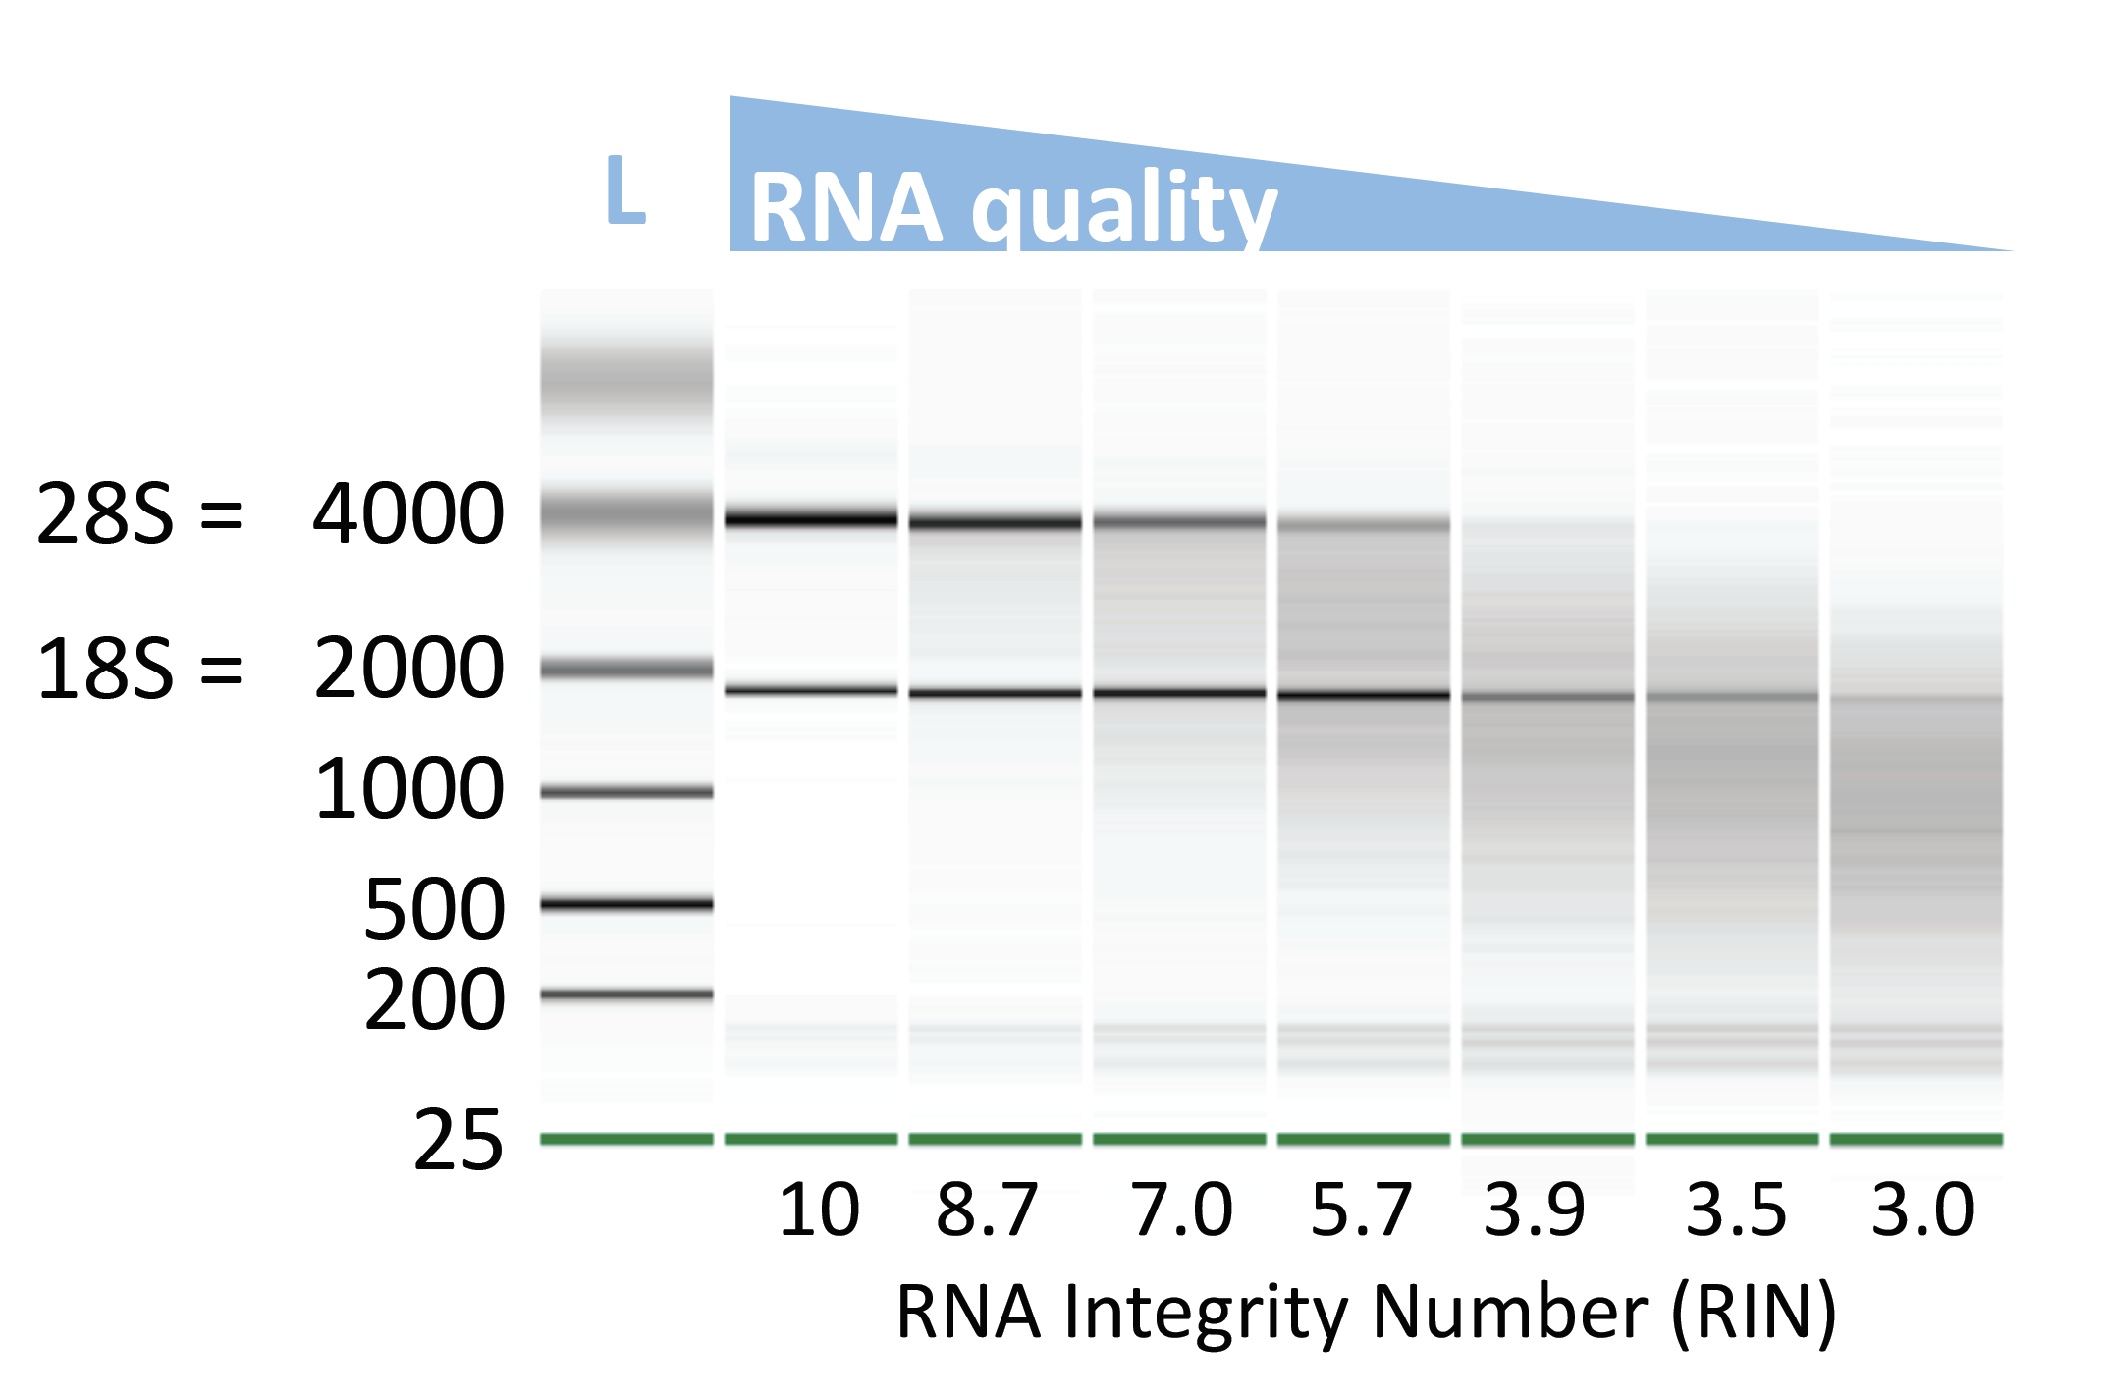
xNA extraction
Key point:
✓ xNA quality is crucial
Quality control:
Quantity (ng/μl):
Qubit: RNA or DNA High Sensitivity (HS) Assay Kit (ThermoFisher)
Quality (length):
Capillary electrophoresis
Tapestation (Agilent)
High Sensitivity DNA or RNA ScreenTape
Gel electrophoresis
Regular agarose gel for DNA
TBE-urea gel for RNA
Notes:
After extraction, it’s important to assess sample quality, as that will have a major impact on the downstream steps of library preparation and eventually the quality of your sequencing data. Quality is defined by not only the concentration of nucleic acid, but also the length of your extracted DNA or RNA. The best way to measure concentration is by Qubit fluorometer. This will give you much more accurate values than a UV-absorbance based method, like the Nanodrop.
To assess quality or length, capillary electrophoresis is the most sensitive method, using a Tapestation or a Bioanalyzer for example. But you could also do gel electrophoresis but you’ll lose more material with that. The graph on the right shows the profiles you can expect from samples with high to low RNA quality. If high quality, the ribosomal RNA peaks will be very prominent, either 28S and 18S when a lot of human RNA is present, or 23S and 16S when its mostly bacterial RNA. Some machines will automatically assign a RNA Integrity Number or RIN to samples, which are a measure for RNA quality. Knowing the quality of your RNA is important, as it will inform you on how long you you’ll need to fragment your nucleic acid in the first steps of library prep.

Slide 7
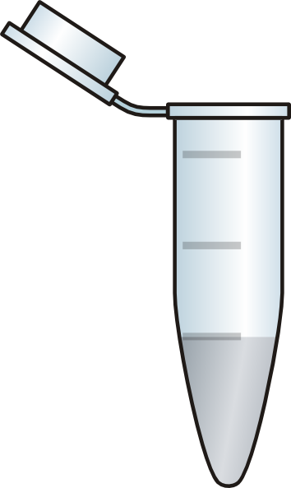
xNA extraction
Keep in mind:
Magnetic stands for 1.5 ml tubes usually accommodate only 8 tubes at a time
Cross-contamination should be avoided as much as possible!!
Process samples with high pathogen content separately from samples with low pathogen content (if you can)
Use water controls to estimate the level of cross-contamination
Space out samples with water controls, and/or empty spots in the magnetic rack
E.g. for 4 samples:
sample
H₂O
sample
H₂O
sample
H₂O
sample
empty

Slide 8
Next step: Library prep

Slide 9
Considerations when using Nanopore (ONT) sequencing
Sample integrity
Important to ensure high quality nucleic acid with little to no degradation
Optimize sample handling and storage
Library preparation kit (link to available kits)
DNA or RNA?
PCR or PCR-free?
Multiplexing or single sample?

Slide 10
Considerations when using Nanopore (ONT) sequencing
Sample integrity
Important to ensure high quality nucleic acid with little to no degradation
Optimize sample handling and storage
Library preparation kit (link to available kits)
DNA or RNA?
PCR or PCR-free?
Multiplexing or single sample?
Kit used for ONT RNA mNGS SMART-9N:
Rapid PCR barcoding kit (SQK-RPB114.24)

Slide 11
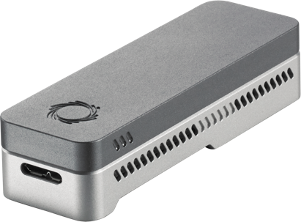

ONT mNGS pipeline
Study design
xNA extraction
Library prep
Sequencing
Data analysis
Pathogen ID

Slide 12
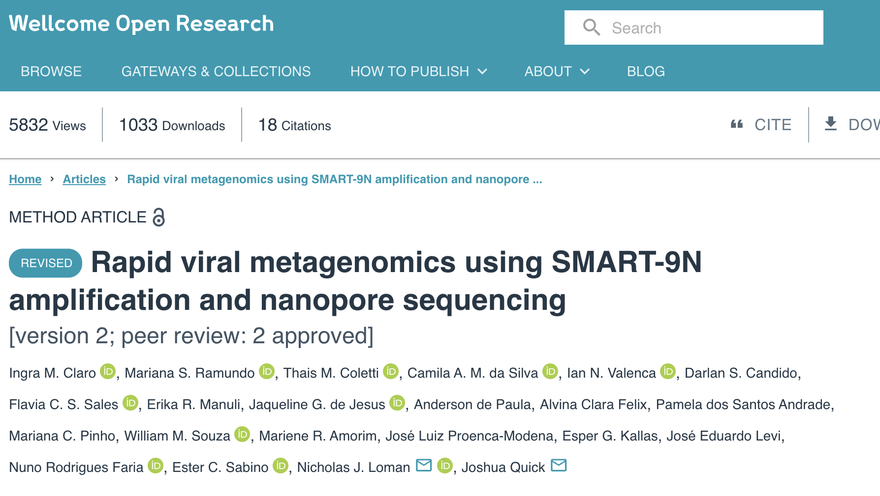
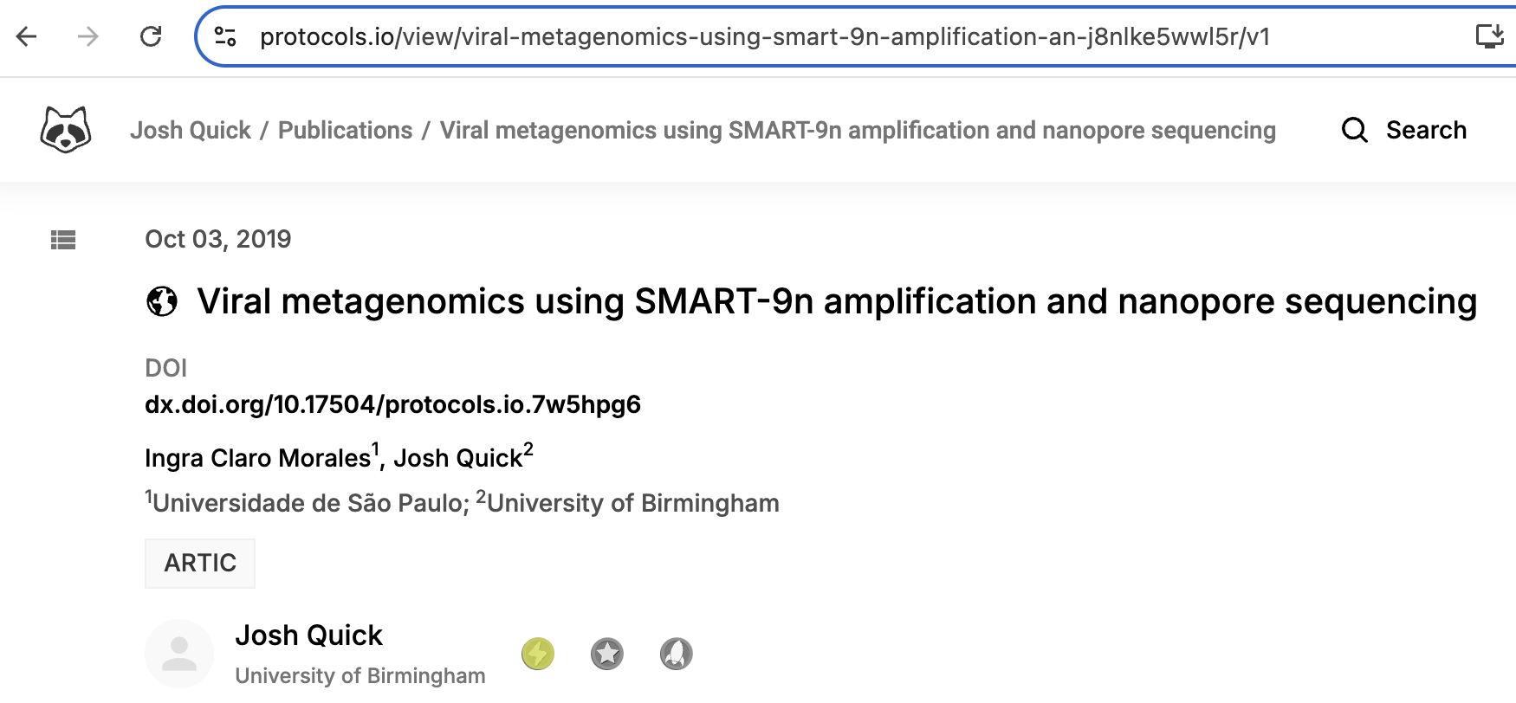
RNA mNGS using Nanopore
For RNA mNGS using Nanopore, we use the SMART-9N protocol with minor modifications
Increase concentration of oligos for reverse transcription steps
Adjust annealing temperature for PCR
https://doi.org/10.12688/wellcomeopenres.17170.2
dx.doi.org/10.17504/protocols.io.7w5hpg6

Slide 13
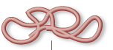

Library prep: RNA to sequencing library
Sequencing library = Pool of DNA inserts with sequencing adapters attached
Extracted RNA
Sequencing library

Slide 14
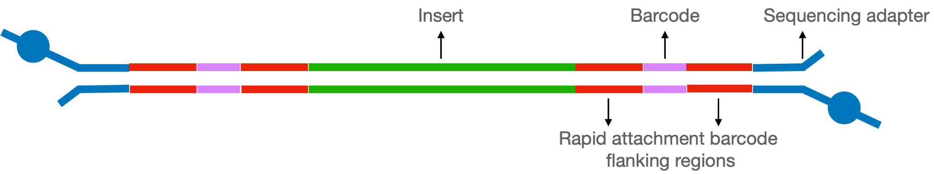
Anatomy of a completed ONT library
Sequencing Adapter
Insert
Barcode
Motor protein
Rapid attachment barcode flanking region 1
Rapid attachment barcode flanking region 2

Slide 15
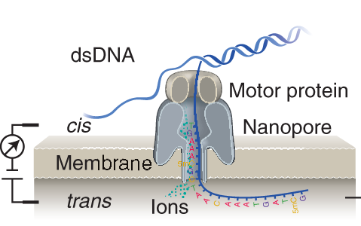
Anatomy of a completed ONT library
Sequencing Adapter
Insert
Barcode
Motor protein
Rapid attachment barcode flanking region 1
Rapid attachment barcode flanking region 2

Slide 16
Anatomy of a completed ONT library
Sequencing Adapter
Insert
Barcode
Motor protein
Rapid attachment barcode flanking region 1
Rapid attachment barcode flanking region 2
Insert: cDNA target that will be sequenced
Rapid attachment barcode flanking region 1: adapter region allows barcode primer to bind for PCR priming; added during cDNA synthesis
Barcode: DNA barcode specific to each sample; added during PCR amplification
Rapid attachment barcode flanking region 2: includes special molecule for sequencing adapter ligation; included in barcode primer, added during PCR amplification
Sequencing adapter: allows binding and movement of DNA through flow cell sequencing pores; includes motor protein; added during sequencing adapter ligation

Slide 17
Steps in RNA mNGS library prep for ONT (SMART-9N)
Annealing
Reverse transcription + template switching
Barcoding PCR
Clean-up, quantification, and pooling
Sequencing adapter ligation

Slide 18
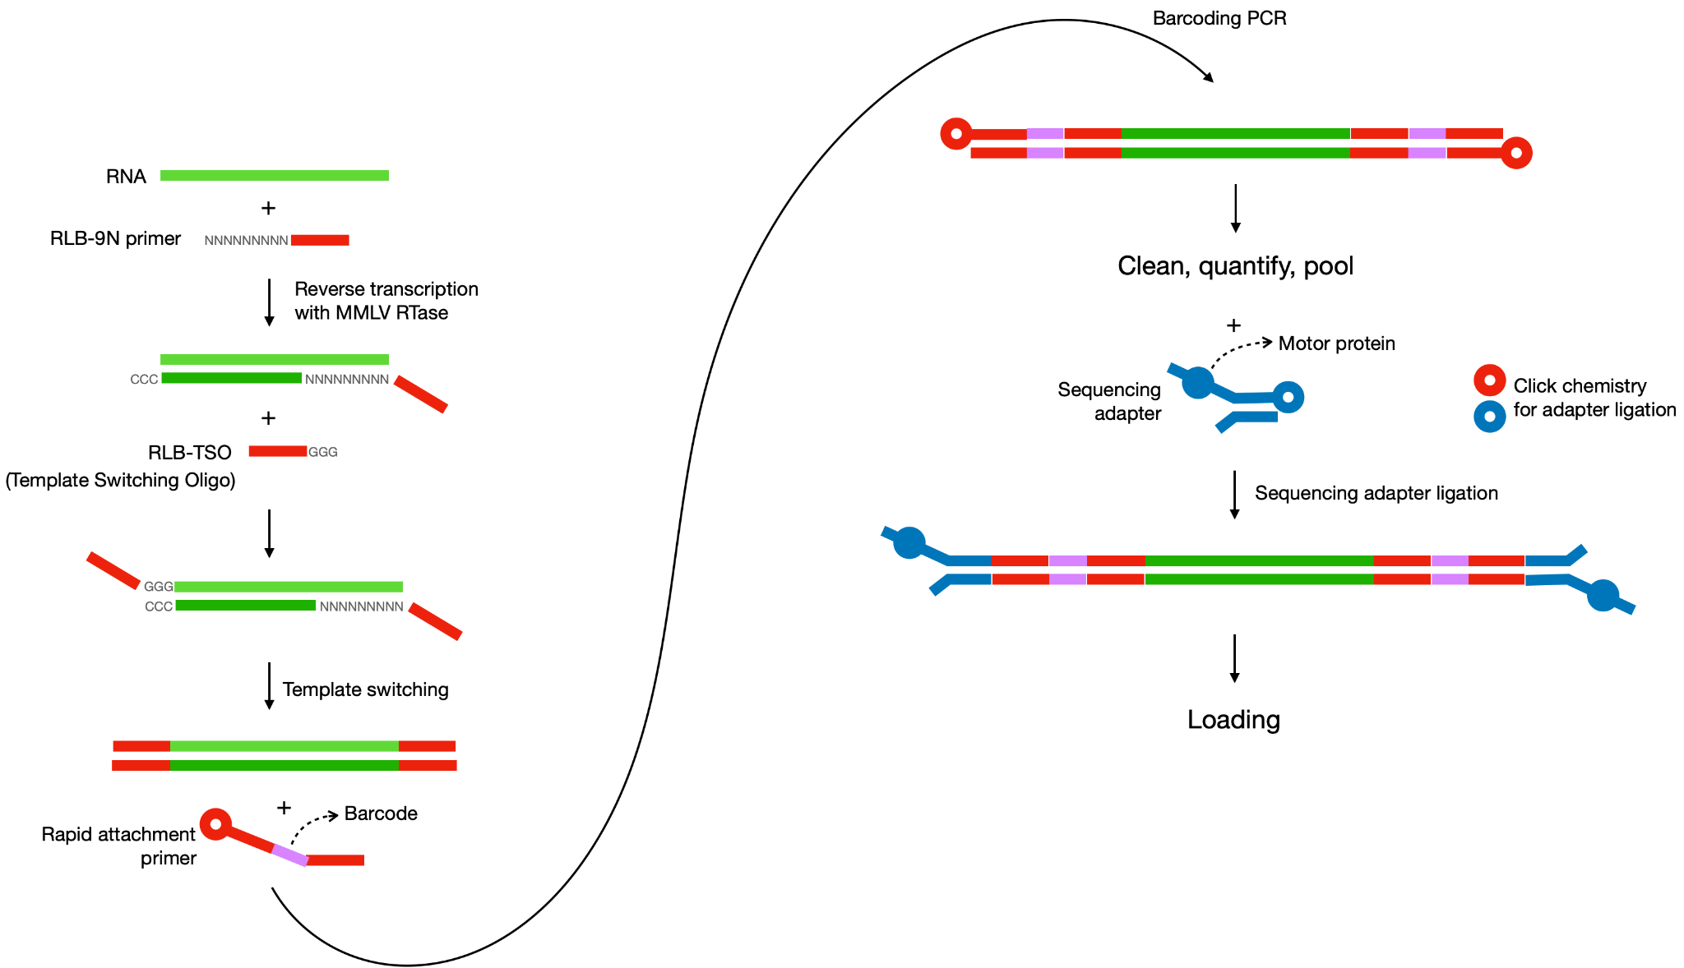
RNA mNGS library prep for ONT (SMART-9N)

Slide 19
RNA mNGS library prep for ONT (SMART-9N)
STEP 0. Starting material: RNA or TNA
(pre-PCR lab)
RNA only: move on to annealing and reverse transcription
TNA (total nucleic acid): need to remove DNA
Aliquot sample
DNAse treatment
SPRI bead cleanup (2x)
Qubit quantification

Slide 20
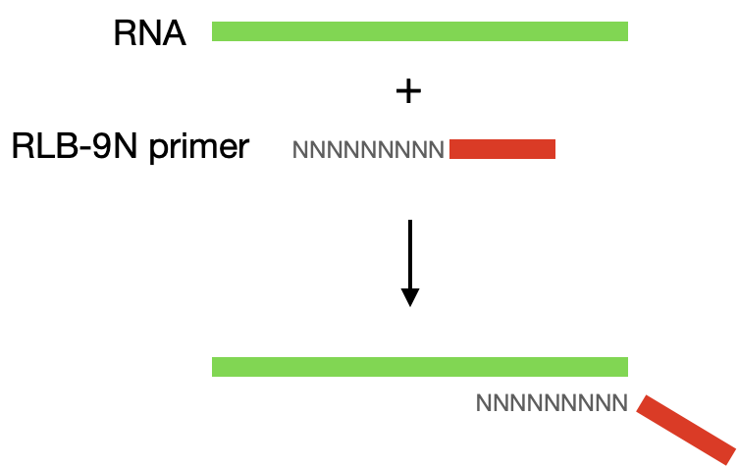
RNA mNGS library prep for ONT (SMART-9N)
STEP 1. Annealing
(pre-PCR lab)
RLB-9N primer: ONT adaptor with random nonamer
ONT adaptor sequence corresponds to the transposase adapter used in Rapid PCR Barcoding kit

Slide 21
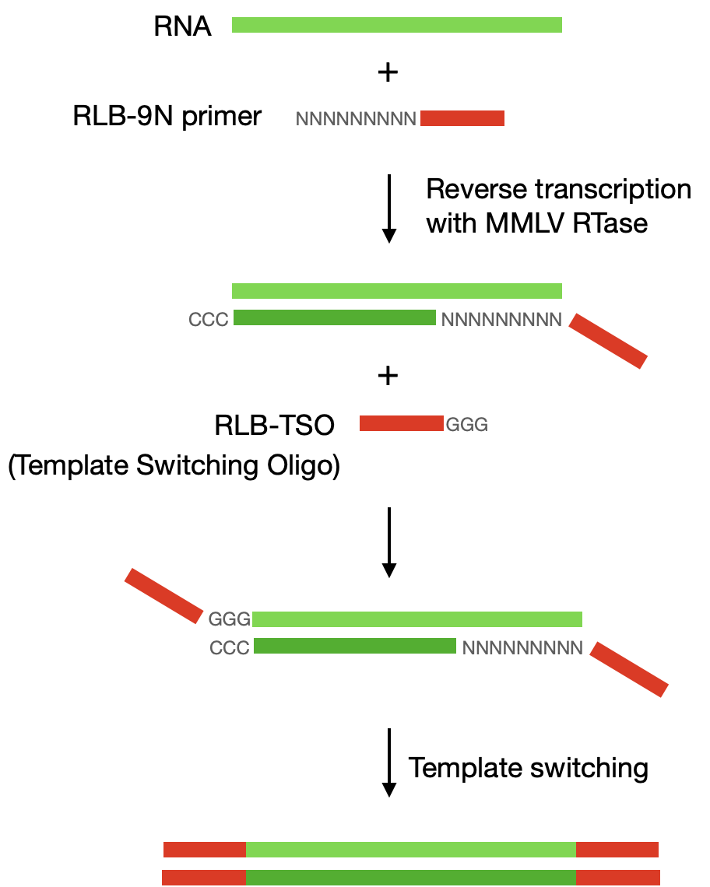
RNA mNGS library prep for ONT (SMART-9N)
STEP 2. Reverse transcription + template switching (pre-PCR lab)
RNase OUT + DTT → degrade any RNases present
Special RTase is used that adds CCC at the end (MMLV)
RLB-TSO: Template Switching Oligo → anneals to CCC and generates the template switched oligo

Slide 22
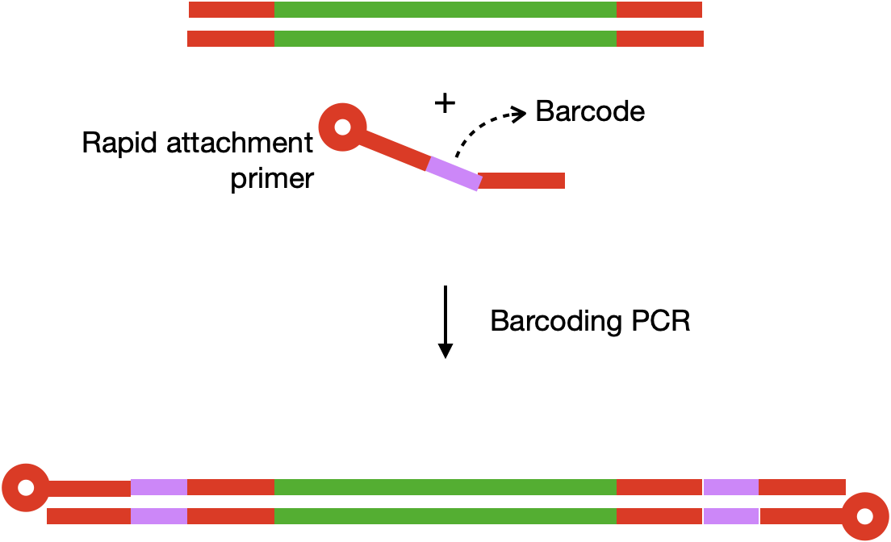
RNA mNGS library prep for ONT (SMART-9N)
STEP 3. Barcoding PCR
(prep pre-PCR lab, amplify in post-PCR)
Barcoding primers: single barcode, same primer amplifies both ends of each sample
Barcoding primers have a modified end to facilitate sequencing adapter ligation
ONT calls these “single rapid attachment primers” and they come with the ONT kit
PCR conditions:
Number of PCR cycles depends on the input; for low input, perform 25 cycles
Long extension time used since samples are unfragmented

Slide 23
RNA mNGS library prep for ONT (SMART-9N)
STEP 4. Clean-up, QC, and pooling
(post-PCR lab)
Perform 0.6x SPRI clean-up of libraries after barcoding PCR
Do QC (quantity and quality)
If running Tapestation, use the genomic screentape
Ideal size range should be ~1000-7000 bp
Pooling
The goal is to have 100-150 fmol of library in 11µL
(This corresponds to a concentration of 10-15 nM)
Pooling can be done in nuclease-free water or EB as the kit says (anecdotally, water works better)

Slide 24
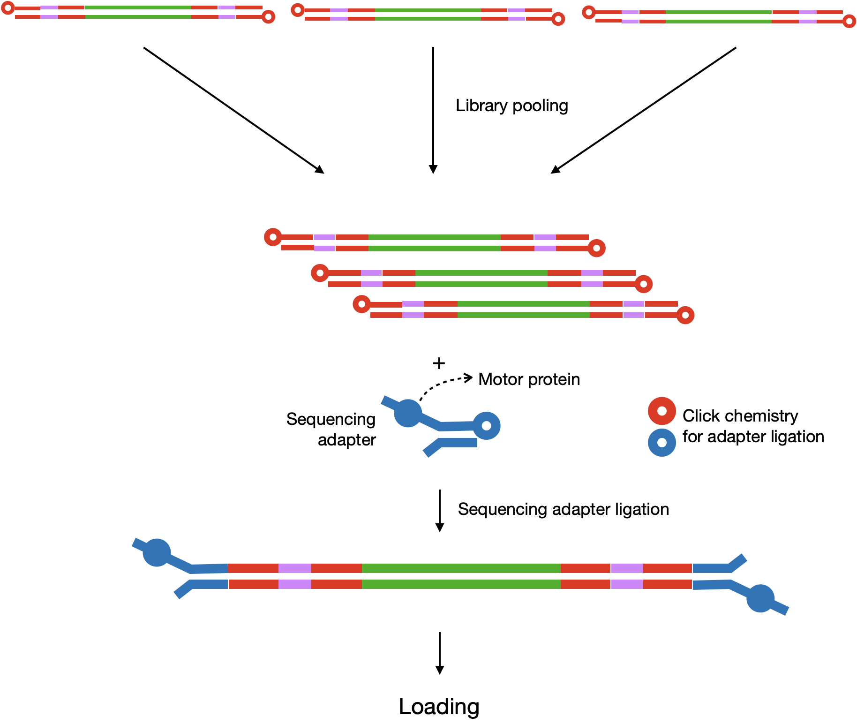
RNA mNGS library prep for ONT (SMART-9N)
STEP 5. Sequencing adapter ligation
(post-PCR lab, immediately before sequencing)
ONT sequencing adapters have a motor protein attached to it that helps guide the DNA through the nanopores
Ligation of adapter occurs in 5 min using a proprietary click chemistry

Slide 25
Resources
RNA and DNA mNGS for ONT:
CZ Biohub Protocols: Nanopore Metagenomics (mNGS)

Slide 26
Next step:
Library QC

